Slide 1
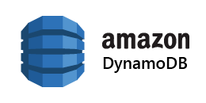
Dynamo
Amazon’s Highly Available Key-value Store
Presented by: Cyber Infrastructure for Researchers Team
Tian Chen, Donovan Jones, Komal Kango, Jing Song & Kristi Perreault

Slide 2
Overview
What is Dynamo?
Data Distribution
Replication
Solution for Inconsistencies
Failure Handling
Membership and Failure detection
Experiences
Summary
Notes:
Dynamo is embedded in each application, could be highly customized

Slide 3

What is Dynamo?
Dynamo is a highly available primary-key only storage system which provides an “always on” experience.
Dynamo is the underlying storage technology for Amazon’s e-commerce platform (across multiple data centers) since it is able to scale to peak load efficiency without any downtime.
Notes:
Eventually consistent data store: all updates reach all replicas eventually “Always Writable” data store: highly available for writes-- want it to support a range of applications, can control consitency and include applications that databases couldnt support like always writable
Forces conflict resolution onto reads so that the writes are never rejected
Conflict resolution is done by the application, allowing more options such as merge instead of last write wins
Incremental scalability
Dynamo can scale out one node at a time with little impact on system and system operator
Symmetry
Every node has the same set of responsibilities as its neighbors
There are no special nodes with extra responsibilities
Decentralization
Simpler, more scalable, more available since this avoids outages-- we’ve seen 2 things already this is what we have
Heterogeneity -- distribution must be proportional to the capabilities of the
individual servers.
Work distribution is proportional to capabilities of individual servers
Used when adding new nodes with higher capacity without needing to upgrade all hosts at once.
-- not hero
Not actually an “Always Writable” data store - what you to always be able to “write” to the cart. Can configure Dynamo to not always be writable.
Support range of apps

Slide 4
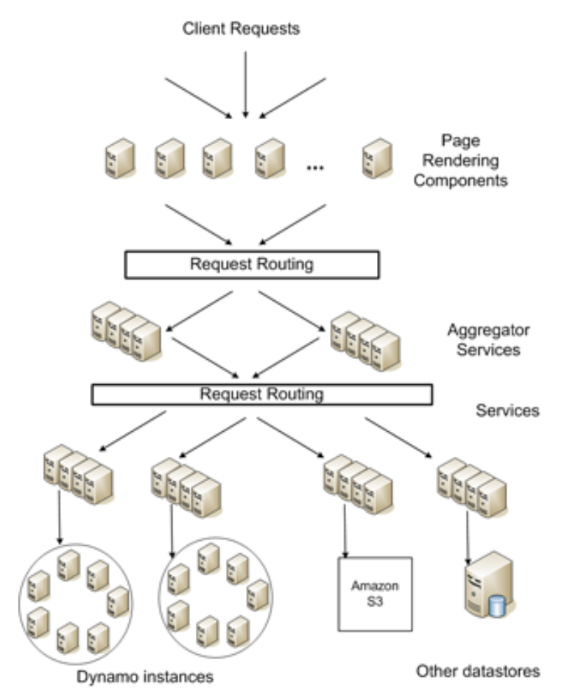
Amazon’s Requirements for Dynamo
99.9 percentile tail latency
Figure 1 from Dynamo Paper
Notes:
Readline. The design of Dynamo provides insights into how techniques can be tuned to meet requirements of production systems with very strict performance demands
Dynamo provides support for hundreds of services, such as in Amazon’s e-commerce platform. Downtime or loss of functionality is NOT tolerated because it needs expected performance measured to the 99.9 percentile
In order for Dynamo to achieve scalability and availability, data is partitioned and replicated using consistent hashing-- this reduced latency with look-ups
Dynamo also incorporates consistency by utilizing object versioning. Specifically in replicas during updates, consistency is maintained by quorum-like techniques and a decentralized replica synchronization protocol. Gossip protocol is used for distributed failure detection and membership which we will talk more on in later slides.
Discuss the problem more in the beginning - what is Dynamo trying to solve?: requests are slow (99.9 percentile tail latency) - why couldn’t we use Db2, sql, etc - they are willing to sacrifice consistency for availability (always handle every request)
What they care about here - tail latency, care that 1/1000 requests is slower than 300ms
Give an example how they relax consistency: application decides how to handle (you can get inconsistencies, not letting DB handle it); amazon shopping cart
Introducing “Consistent Hashing” w/o talking to it
Add a figure like Figure 1 in the paper

Slide 5
System Simplifications
Query Model
Simple Read and Write operations to data item that is identified by a unique key
Weaker consistency to achieve higher availability
Notes:
Eventually consistent data store: all updates reach all replicas eventually “Always Writable” data store: highly available for writes-- want it to support a range of applications, can control consitency and include applications that databases couldnt support like always writable
Forces conflict resolution onto reads so that the writes are never rejected
Conflict resolution is done by the application, allowing more options such as merge instead of last write wins
Incremental scalability
Dynamo can scale out one node at a time with little impact on system and system operator
Symmetry
Every node has the same set of responsibilities as its neighbors
There are no special nodes with extra responsibilities
Decentralization
Simpler, more scalable, more available since this avoids outages-- we’ve seen 2 things already this is what we have
Heterogeneity -- distribution must be proportional to the capabilities of the
individual servers.
Work distribution is proportional to capabilities of individual servers
Used when adding new nodes with higher capacity without needing to upgrade all hosts at once.
-- not hero
Not actually an “Always Writable” data store - what you to always be able to “write” to the cart. Can configure Dynamo to not always be writable.
Support range of apps

Slide 6
Key Design Aspects
Eventually consistent data store
All updates reach all replicas eventually
Highly available for Writes
Conflict Resolution is done by Application
Notes:
Eventually consistent data store: all updates reach all replicas eventually “Always Writable” data store: highly available for writes-- want it to support a range of applications, can control consitency and include applications that databases couldnt support like always writable
Forces conflict resolution onto reads so that the writes are never rejected
Conflict resolution is done by the application, allowing more options such as merge instead of last write wins
Incremental scalability
Dynamo can scale out one node at a time with little impact on system and system operator
Symmetry
Every node has the same set of responsibilities as its neighbors
There are no special nodes with extra responsibilities
Decentralization
Simpler, more scalable, more available since this avoids outages-- we’ve seen 2 things already this is what we have
Heterogeneity -- distribution must be proportional to the capabilities of the
individual servers.
Work distribution is proportional to capabilities of individual servers
Used when adding new nodes with higher capacity without needing to upgrade all hosts at once.
-- not hero
Not actually an “Always Writable” data store - what you to always be able to “write” to the cart. Can configure Dynamo to not always be writable.
Support range of apps

Slide 7
Other Design Aspects
Incremental scalability
Symmetry
Decentralization
Heterogeneity
Notes:
Eventually consistent data store: all updates reach all replicas eventually “Always Writable” data store: highly available for writes-- want it to support a range of applications, can control consitency and include applications that databases couldnt support like always writable
Forces conflict resolution onto reads so that the writes are never rejected
Conflict resolution is done by the application, allowing more options such as merge instead of last write wins
Incremental scalability
Dynamo can scale out one node at a time with little impact on system and system operator
Symmetry
Every node has the same set of responsibilities as its neighbors
There are no special nodes with extra responsibilities
Decentralization
Simpler, more scalable, more available since this avoids outages-- we’ve seen 2 things already this is what we have
Heterogeneity -- distribution must be proportional to the capabilities of the
individual servers.
Work distribution is proportional to capabilities of individual servers
Used when adding new nodes with higher capacity without needing to upgrade all hosts at once.
-- not hero
Not actually an “Always Writable” data store - what you to always be able to “write” to the cart. Can configure Dynamo to not always be writable.
Support range of apps

Slide 8
Overview
What is Dynamo?
Data Distribution
Replication
Solution for Inconsistencies
Failure Handling
Membership and Failure detection
Experiences
Summary
Notes:
Dynamo is embedded in each application, could be highly customized

Slide 9
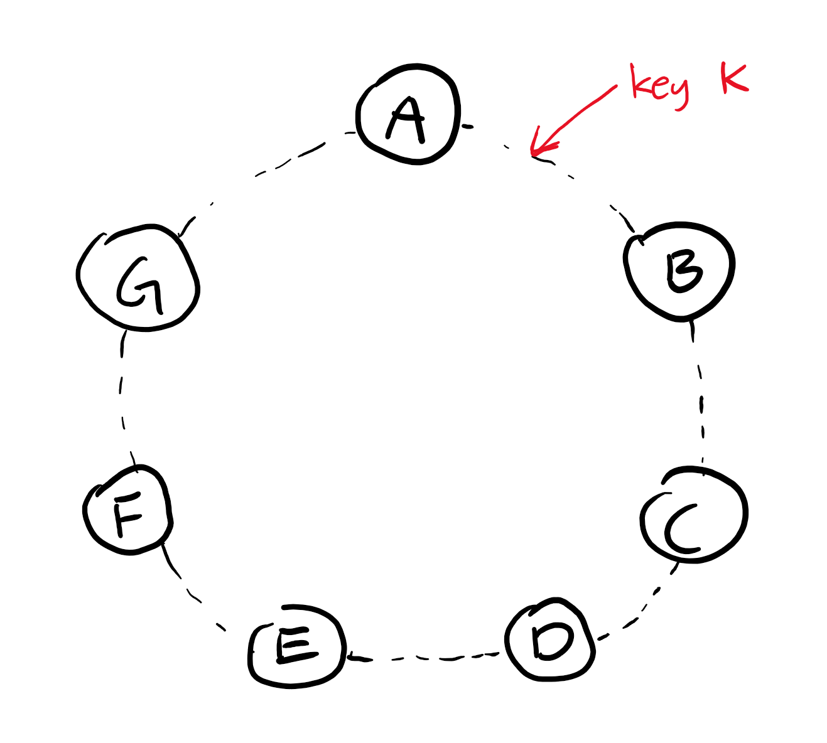
Partition Algorithm: Consistent Hashing
Why Consistent Hashing?
Remap Less Keys
Problems with Typical Consistent Hashing
Randomly assign node to a position→ non-uniform distribution
Does not account for performance heterogeneity
Notes:
Value of consistent hashing, why consistent hashing?
Consisteny
If B node disappears, next node is responsible for handling the keys, shifting only a set of data items
Each physical node appears in multiple spots of the ring
Put animation for consistent hashing

Slide 10
Dynamo’s Solution for Consistent Hashing
Virtual Nodes
Map one node to multiple positions in the ring
Advantages
Load distributed uniformly on the available node
New node receives equivalent load from the available nodes
Heterogeneity
Handling unable nodes:
Notes:
Pictures / animation!!! -- I dont know
Show removing a node, how the load is distributed

Slide 11
Overview
What is Dynamo?
Data Distribution
Replication
Solution for Inconsistencies
Failure Handling
Membership and Failure detection
Experiences
Summary
Notes:
Dynamo is embedded in each application, could be highly customized

Slide 12
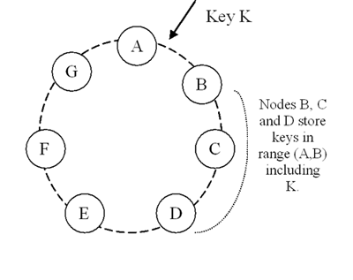
Replication
Coordinator
N: a system parameter indicating how many replicas should be made
Suppose N = 3

Slide 13
Replication
Preference List: the list of nodes that are responsible for storing a particular key
Preference List of Key K

Slide 14
Overview
What is Dynamo?
Data Distribution
Replication
Solution for Inconsistencies
Failure Handling
Membership and Failure detection
Experiences
Summary
Notes:
Dynamo is embedded in each application, could be highly customized

Slide 15

This should be familiar...
Check out your cart → get(key):
Finds the object replicas based on the key
Returns the object or a list of objects with conflicting versions, together with a context
Context: encoded system metadata about the object

Slide 16
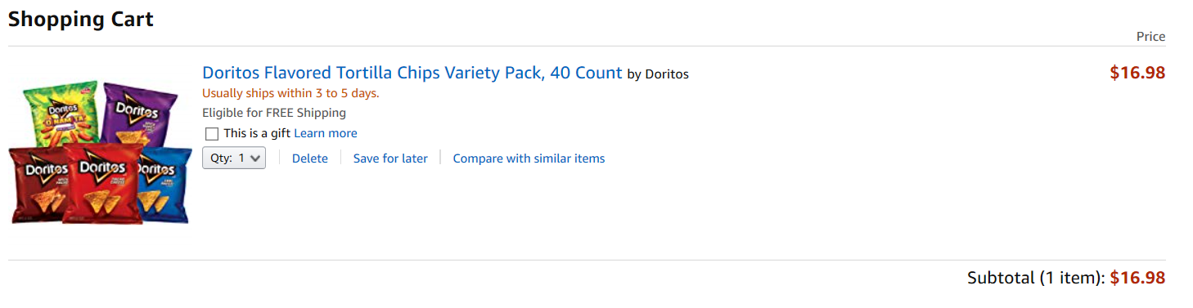
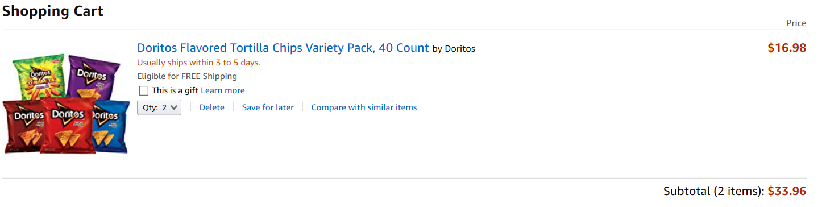
Craving for Doritos...
Add items to your cart → put(key, context, object):
Determines where to put the replicas of the object
Writes the replicas to disk

Slide 17
Syntactic Reconciliation
Later version subsumes the earlier one
System could determine the authoritative version automatically

Slide 18
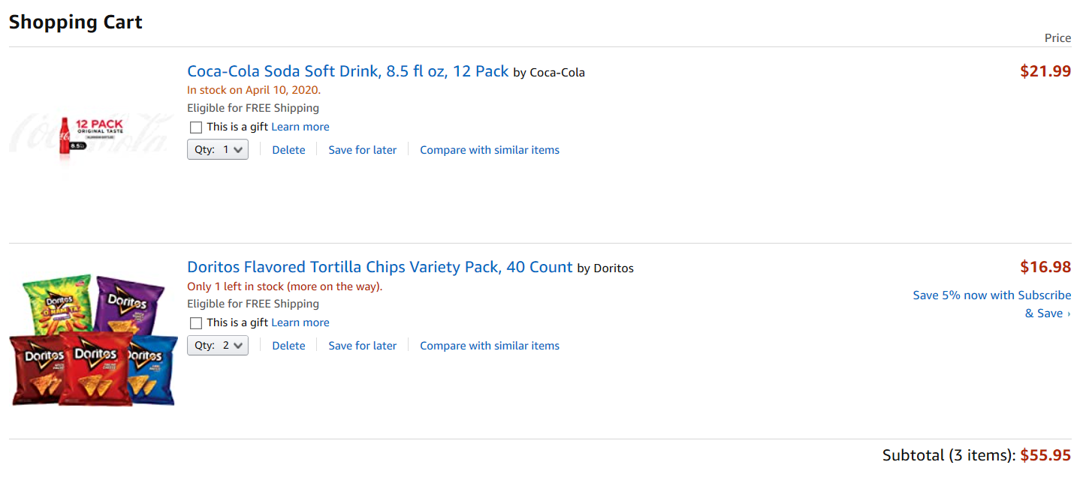
Sister (in California) ’s Suggestion...

Slide 19
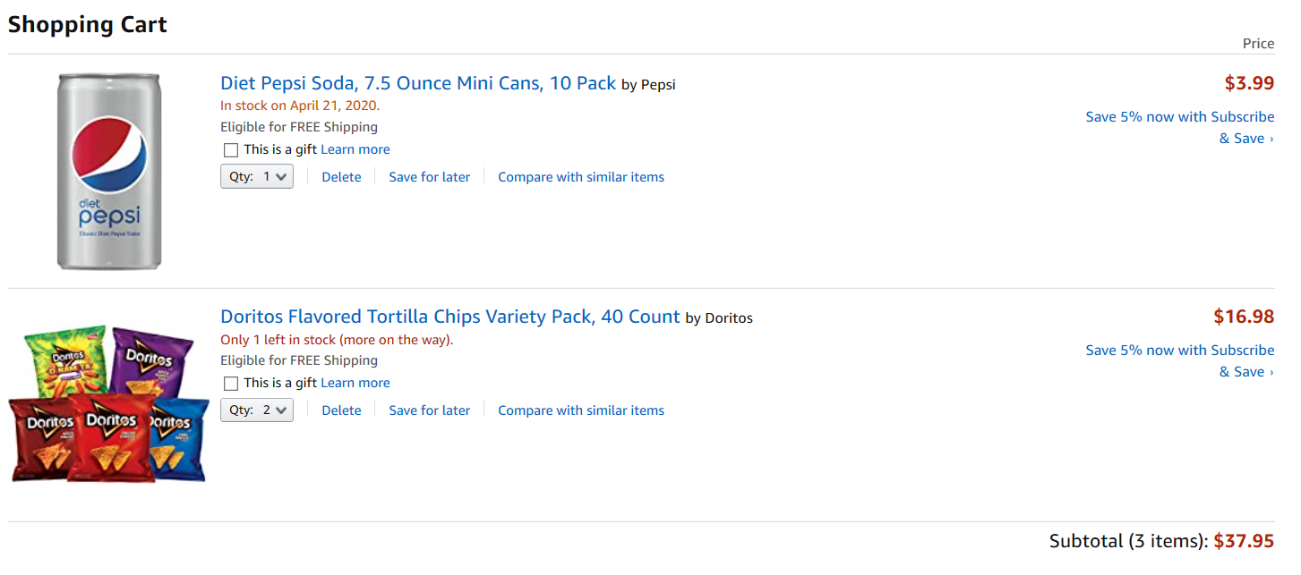
Brother (in Arizona) ’s suggestion...

Slide 20
Semantic Reconciliation
Conflicting Versions
Client applications have to manually perform the reconciliation
Amazon: merge all versions for largest profit

Slide 21
Data Versioning: Vector Clocks
How the system handles multiple, conflicting branches of data evolution
Vector Clocks: a list of (node, counter) pairs that is associated with every version of every object

Slide 22
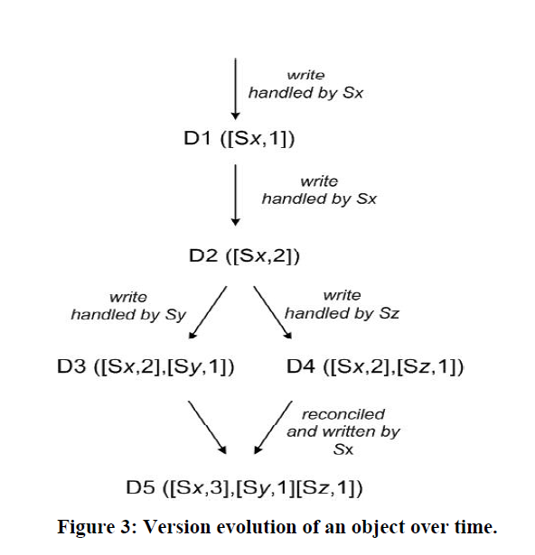
Vector Clocks

Slide 23
Vector Clocks

Slide 24
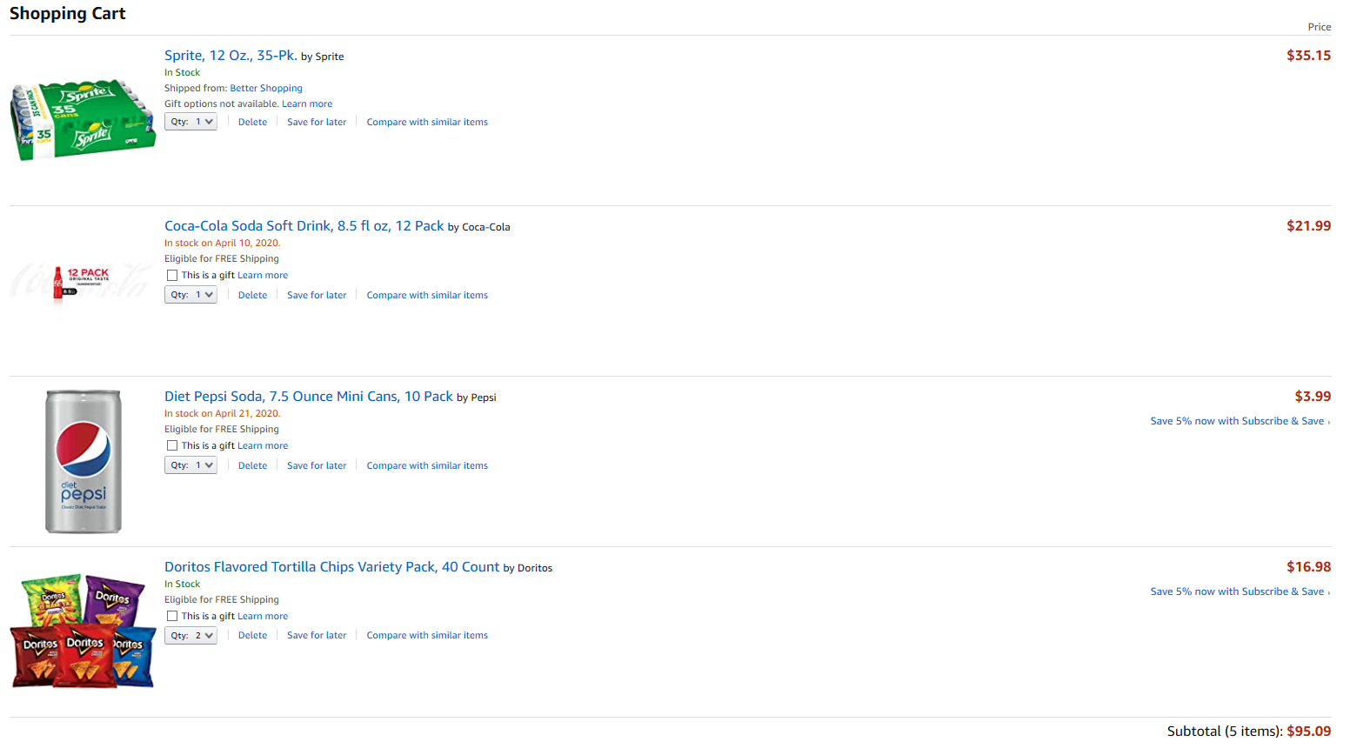
Vector Clocks

Slide 25
Problems with Vector Clocks
In practice, write requests are not always handled by the top N nodes in the preference list
The size of vector clocks will grow
Dynamo’s solution: Clock Truncation Scheme

Slide 26
Sloppy Quorum:
Introducing the problem
How to maintain the consistency among replicas during put() and get() operation?
How can we design the strategy so that we can retrive the same data from any replicas?
Notes:
Introducing the problem

Slide 27
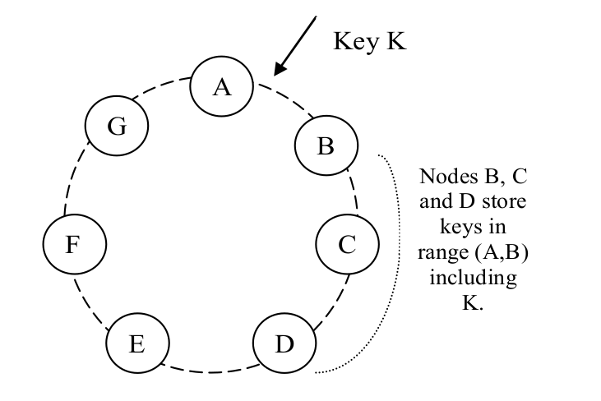
what is the most intuitive idea?
Read-One-Write-All:
Send the data to all replicas
Read from one of them
Notes:
A sample way is rowa

Slide 28
Congratulations! We have realized a consistency model:
Problems:
Write is vulnerable to be affected by node failure
Improvement:
A better model for replicas control
Notes:
So we need to optimize this method in order to balance the latency between read and write while in the meantime, still guarantee the consistency

Slide 29
What is Quorum?
A quorum is the minimum number of votes that a distributed transaction has to obtain in order to be allowed to perform an operation in a distributed system.
A quorum-based technique is implemented to enforce consistent operation in a distributed system.
Notes:
Introducing the problem

Slide 30
Quorum protocol:
This protocol has three values:
R, W and N.
R is the minimum number of nodes that must participate in a successful read operation.
W is the minimum number of nodes that must participate in a successful write operation.
N is the number of nodes that being involved in read or write operation.
Notes:
Introudcing the problem

Slide 31
Quorum protocol:
Setting R and W such that R + W > N yields a quorum-like system.
In this model, the latency of a read (or write) operation is dictated by the slowest of the R (or W) replicas.
Notes:
Introudcing the problem

Slide 32
Quorum protocol in Dynamo in order to maintain the consistency
A request(read or write) involves the first N healthy nodes
Coordinator(the first among the top N healthy nodes) will process the requests and maintain the consistency among its replicas
Coordinator
Notes:
So only the B will process the request and synchorize the data with N nodes

Slide 33
put() operation:
For a put() request:
The coordinator generates the new version (using vector lock)
The coordinator writes the new version locally.
The coordinator sends the new version (along with the new vector clock) to the N highest-ranked reachable nodes.
The write is considered successful if at least W-1 nodes respond .
Notes:
So how quorum works in put and get operation

Slide 34
get() operation:
Similarly, for a get() request:
The coordinator requests all existing versions of data for that key from the N highest-ranked reachable nodes in the preference list for that key.
The coordinator waits for R responses before returning the result to the client.
If the coordinator ends up gathering multiple versions of the data, it returns all the versions it deems to be causally unrelated.
The divergent versions are then reconciled and the reconciled version superseding the current versions is written back.

Slide 35
Why it is called sloppy quorum?
Traditional quorum would be unavailable during server failures and network partitions.
Dynamo does not enforce strict quorum membership.
Instead, it uses a “sloppy quorum”: all read and write operations are performed on the first N healthy nodes from the preference list, which may not always be the first N nodes encountered while walking the consistent hashing ring.

Slide 36
The weakness of Quorum:
Dirty read : it should try to be avoided
Eventual consistency: in some cases we need strong consistency
Notes:
A good distributed system should avoid this

Slide 37
Overview
What is Dynamo?
Data Distribution
Replication
Solution for Inconsistencies
Failure Handling
Membership and Failure detection
Experiences
Summary
Notes:
Dynamo is embedded in each application, could be highly customized

Slide 38
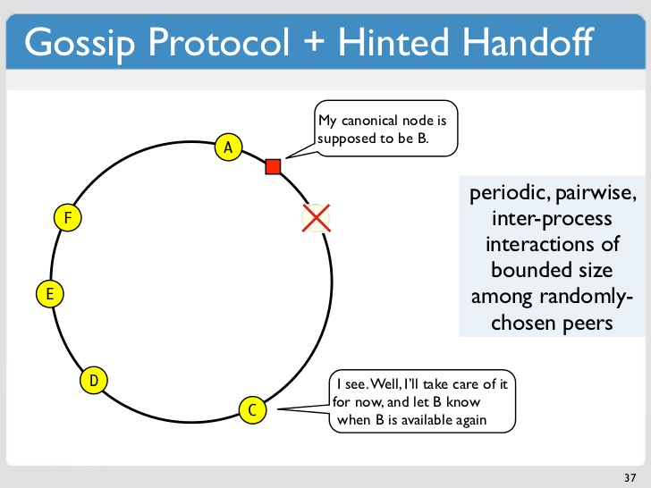
Failure handling:
Hinted handoff
if node A is temporarily down or unreachable during a write operation then a replica that would normally have lived on A will now be sent to node D
Sloppy quorum
Data stays with neighbor node if home node is down
Data returns to home node once it is working again
Ensures durability

Slide 39
Failure handling:
Hinted handoff example
if node A is temporarily down or unreachable during a write operation then a replica that would normally have lived on A will now be sent to node D
Notes:
Home node - B
Temp Node - E

Slide 40
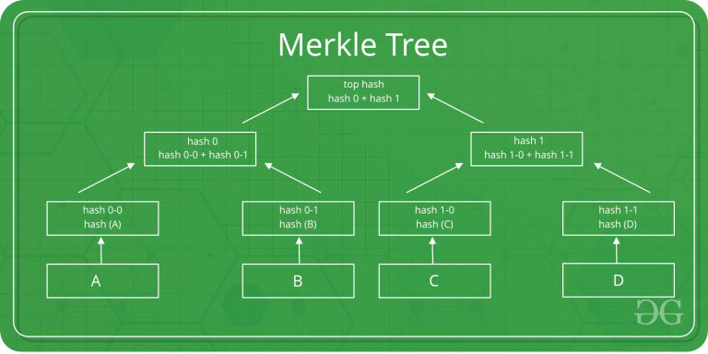
Handling permanent failures: Replica
synchronization
Hinted handoff works best if the system membership churn is low and node failures are transient.
So when node failures are permanent, we need new node to replace the old one, and we need to synchronize those node.
Dynamo implements an anti-entropy (replica synchronization) protocol to keep the replicas synchronized.
Dynamo use Merkle tree to check if the data was up-to-date
Notes:
Failures section
Hinted handoff
Merkle tree

Slide 41
Overview
What is Dynamo?
Data Distribution
Replication
Solution for Inconsistencies
Failure Handling
Membership and Failure detection
Experiences
Summary
Notes:
Dynamo is embedded in each application, could be highly customized

Slide 42
Membership and Failure Detection
Notes:
Node outages are transient but can last for extended intervals. If there is a node outage, does not mean there is a node failure and should not trigger rebalancing of partition. If nodes fail permanently, we need to add new nodes to the ring.
Without a master, how do they communicate?
Dynamo use an explicit mechanism to initiate the addition and removal of nodes from a ring

Slide 43
Membership and Failure Detection
Gossip protocol:
Every node randomly sends their message to others and updates.
Notes:
A gossip-based protocol propagates membership changes and maintains an eventually consist view of membership
Decentralized failure detection protocols use a simple gossip-style protocol that enable each node in the system to learn about the arrival (or departure) of other nodes
Each node contacts a peer chosen at random and the two nodes efficiently reconcile their persisted membership change histories.

Slide 44
Membership and Failure Detection
Problem with this method:
Logically partitioned ring
Dynamo’s Solution:
Some nodes are seeds
Notes:
Logically partitioned AKA: A could tell A to join, B could tell B to join, and they wouldn’t be aware of themselves
Seeds are nodes that are discovered via an external mechanism and are known to all nodes.
Seeds can be obtained either from static configuration or from a configuration service. Typically seeds are fully functional nodes in the Dynamo ring.

Slide 45
Overview
What is Dynamo?
Data Distribution
Replication
Solution for Inconsistencies
Failure Handling
Membership and Failure detection
Experiences
Summary
Notes:
Dynamo is embedded in each application, could be highly customized

Slide 46
Reconciliation
Business Logic Specific Reconciliation
Amazon Shopping Cart
Timestamp Based Reconciliation
Maintaining customer sessions
Notes:
Reconciliation: main patterns Dynamo is used for
Business: Common case for Dynamo. Each data object replicated across multiple nodes. Shopping cart: Its business logic reconciles objects by merging different versions of a customer’s shopping cart - in Amazon’s business interest to have as many items as possible
Timestamp: “Last write wins”: object with largest physical timestamp is correct version

Slide 47
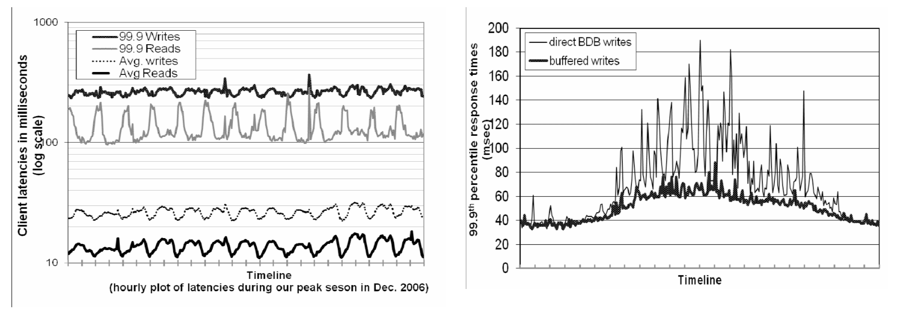
Performance & Durability
Figure 4
Figure 5
Notes:
Review - Dynamo wants to see 99.9 percent of R/W executed within 300ms (tail latency)
Figure 4 shows the average and 99.9th percentile latencies of Dynamo’s read and write operations during a period of 30 days. Significant difference in day/night. the write latencies are higher than read latencies obviously because write operations always results in disk access.
a few customer-facing services required higher levels of performance. For these services, Dynamo provides the ability to trade-off durability guarantees for performance. Each storage node maintains an object buffer in its main memory. Each write operation is stored in the buffer and gets periodically written to storage by a writer thread. In this scheme, read operations first check if the requested key is present in the buffer. If so, the object is read from the buffer instead of the storage engine.
As shown in Figure 5, this optimization has resulted in lowering the 99.9th percentile latency by a factor of 5 during peak traffic even for a very small buffer of a thousand objects. Also, as seen in the figure, write buffering smoothes out higher percentile latencies. Obviously, this scheme trades durability for performance. - “durable write”

Slide 48
Divergent Versions
Shopping cart service profiled for 24hrs
99.4% of requests saw one version
0.00057% of requests saw 2 versions
0.00047% of requests saw 3 versions
0.00009% of requests saw 4 versions
Divergent versions created rarely
Notes:
Developers did an experiment with the shopping cart service - profiled cart for 24hrs and observed divergent versions
Increase in divergent versions is due to increase in number of concurrent writers, not in failures.

Slide 49
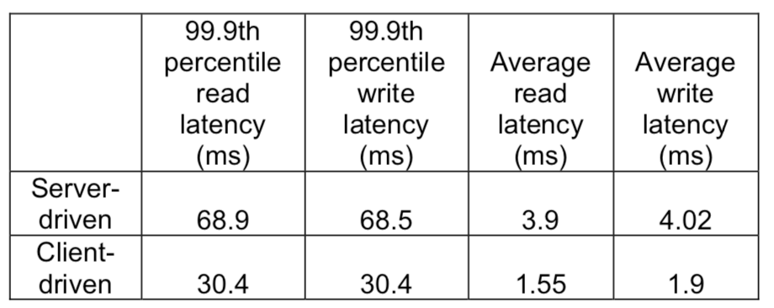
Client & Server Coordination
Client-driven
Load balancer not required
Fair load distribution guaranteed
Pull approach
Better scalability
Less maintenance
Latency significantly less than server coordination
Table 2
Notes:
client-driven coordination approach is that a load balancer is no longer required to uniformly distribute client load. Coordinator is moved to the client (logic moved into client)
server coordination, uses load balancer which results in extra hop.
Currently clients poll a random Dynamo node every 10 seconds for membership updates. A pull based approach was chosen over a push based one as the former scales better with large number of clients and requires very little state to be maintained at servers regarding clients.
Latencies nearly half of what server-driven ones were.
Dynamo typically utilizes server coordination, even though client coordination performs better (paper doesnt explicitly say why, but might assume it is due to more logic being in the client)

Slide 50
Overview
What is Dynamo?
Data Distribution
Replication
Solution for Inconsistencies
Failure Handling
Membership and Failure detection
Experiences
Summary
Notes:
Dynamo is embedded in each application, could be highly customized

Slide 51
Summary
Dynamo is a highly available and scalable data store
Data partitioning with Consistent Hashing
Vector clocks allow for high availability
Temporary Failures
Sloppy Quorum
Hinted Handoff
Permanent Failures
Anti-entropy and Merkle Trees
Membership and failure detection
Gossip-based protocol
Notes:
Key/Value interface
Decentralized system
CH: Incremental scalability
VC: version size decoupled from update rates
Temp Failures: High availability & durability when some replicas not available
Perm Failures: Synchronizes divergent replicas in background
Mem & Fail: preserves symmetry & avoids need for centralized registry for storing mem & node liveness
The main advantage of Dynamo is that its client applications can tune the values of N, R and W to achieve their desired levels of performance, availability and durability.

Slide 52
Where is Dynamo Now?
Data store in Amazon Shopping Cart
Amazon Web Services DynamoDB
NoSQL database service
BUT centralized
Same principles as Dynamo
Notes:
In 2007 Dynamo was created to solve the issues in the Amazon Shopping Cart - always available for writes, you would never lose anything in the cart (app does conflict resolution, not DB)
Amazon DynamoDB is a fully managed proprietary NoSQL database service that supports key-value and document data structures and is offered by Amazon.com as part of the Amazon Web Services portfolio. DynamoDB exposes a similar data model to and derives its name from Dynamo, but has a different underlying implementation.
No relational model
Availability > Consistency
Infinitely scalable

Slide 53
Questions?

